Slide 1
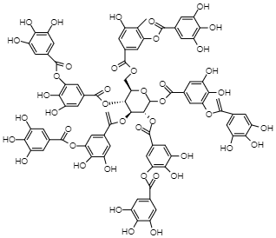
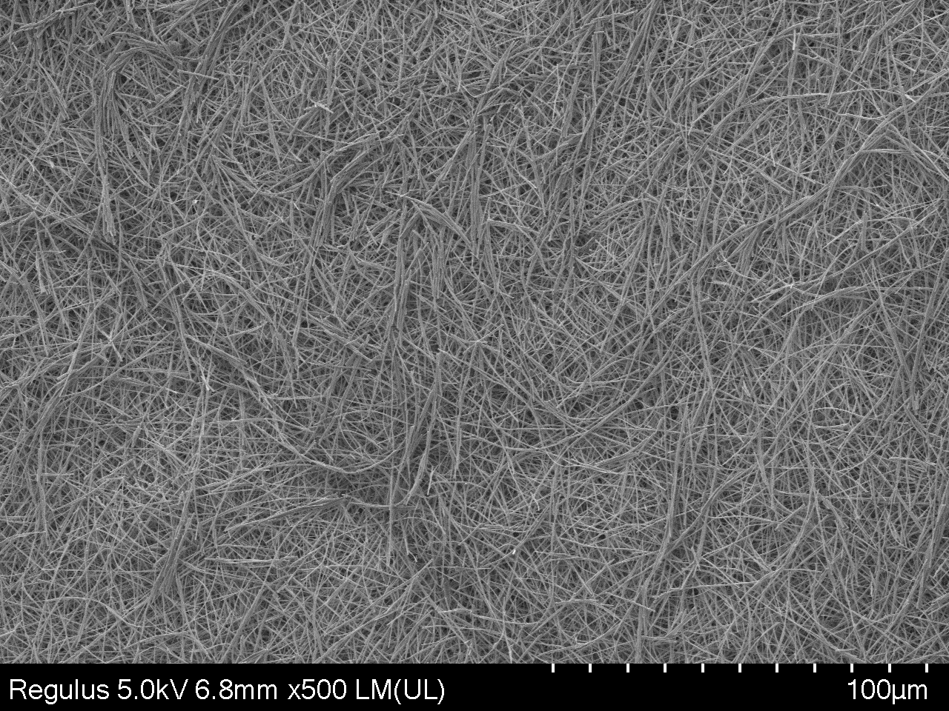
Graphical Abstract
Collector
Syringe
mL/hr
Syringe Pump
High Voltage (kV)

